Slide 1
Emergency Tips
Narration by Bill Roth, Voice of the Hokies
Notes:
***** Press the “ F5 ” button on your keyboard to start the slideshow *****

Slide 2
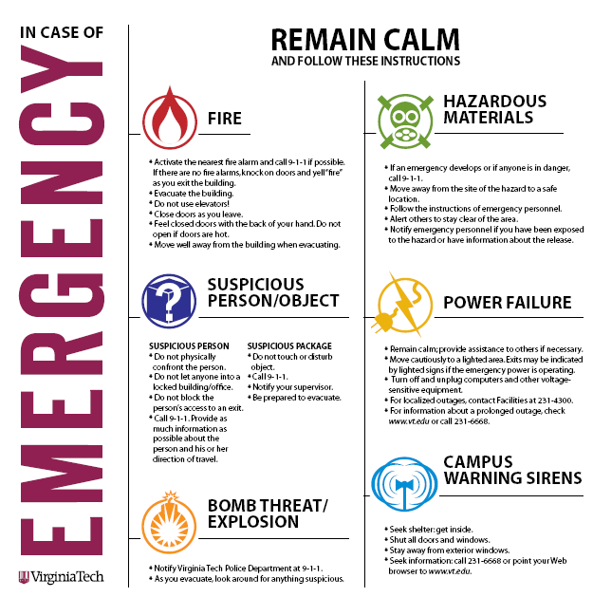
Notes:
You will see these posters on campus with emergency tips. They are also available online on the Virginia Tech Police Department’s website at www.Police.VT.edu.

Slide 3
Emergency 911
Non Emergency 540-231-6411
Crime Hotline 540-232-TIPS
Safe Ride 540-231-SAFE

Slide 4
Notes:
Please familiarize yourself with the evacuation routes that are posted in each building on campus. Fire alarms are monitored by the Virginia Tech Police Department. If an alarm activates, simply follow these tips. Evacuate every time, and do not reenter until the “all clear” is sounded.
DONE!!

Slide 5
Notes:
If the warning siren sounds, remember the Four “S”es. Seek shelter, shut all doors and windows, stay away from exterior windows and seek information. You can call 231-6668 or go to the Virginia Tech homepage at www.vt.edu for information.

Slide 6
Notes:
If you witness someone acting suspiciously, or an object that seems out of place, report it to the Virginia Tech Police Department. If a person or situation makes you feel uneasy, trust your instincts and report it.

Slide 7
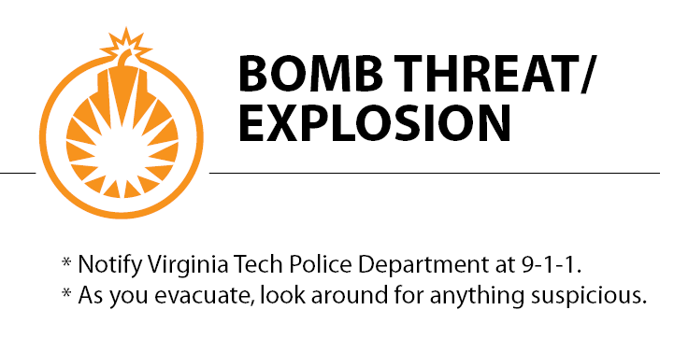
Notes:
If you see or hear a bomb threat, evacuate immediately, then report it.

Slide 8
Notes:
If you are in a building during a power outage, remain calm and wait to see if a generator comes on to provide emergency lighting. Then move cautiously to a lit area. For localized outages you can contact facilities at 231-4300, and for prolonged outages call 231-6668.
ADD MORE VERBAGE!!!

Slide 9
Notes:
If a hazardous material spill happens please follow these tips: Move away from the hazard and call 911. Alert others to stay clear of the area until emergency personnel arrive. Be sure to notify those responding if you have been exposed to the hazard, or you have information about its release.
Also contact your supervisor if you discover bodily fluids, such as blood, vomit, etc.

Slide 10
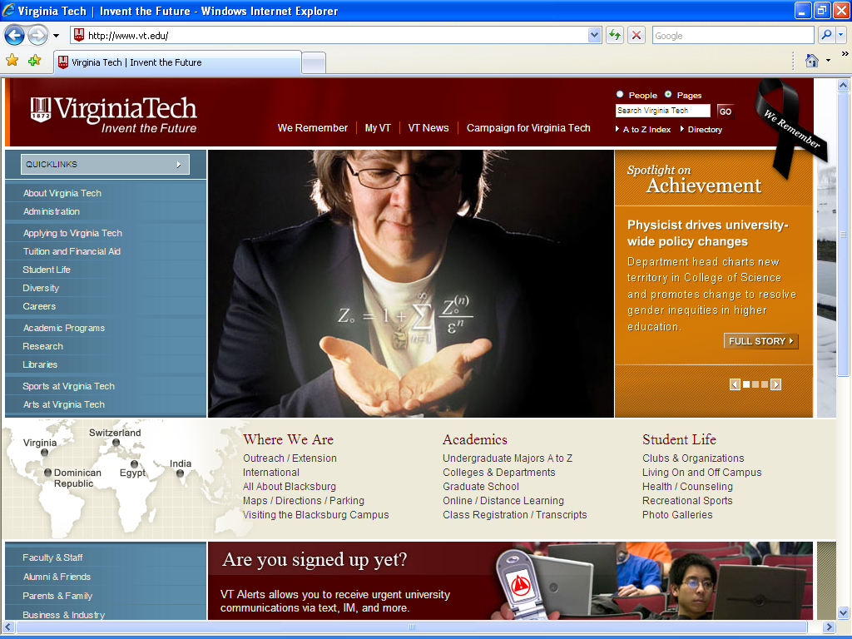
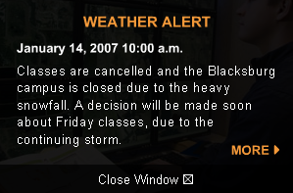
www.VT.edu
Notes:
The best source from which to seek information is the Virginia Tech website at www.vt.edu. If a situation were to occur, an alert would be added to the homepage giving information on appropriate actions to be taken. Criminal alerts can be found on the Virginia Tech Police Department’s website at www.Police.VT.edu.
DONE!!!

Slide 11
VT ALERTS
VT Alerts is Virginia Tech's urgent notification system that the university will use to contact students, faculty, and staff about emergency situations. Contact methods include:
Text messages (SMS) to mobile devices
Instant messages (AOL, MSN, and Yahoo)
Calls to home, office, or mobile phone numbers
E-mails to non-Virginia Tech addresses
Notes:
The VT Alerts system allows the University to contact students, faculty, and staff through text messages, instant messages, phone calls, and email. Students, faculty, and staff must sign up to receive these alerts. A link to the signup page is also on the Virginia Tech Police Department’s website at www.Police.VT.edu.
There are other means of notification that are available to Virginia Tech. The Blast Email system gives the university the option of sending all vt.edu addresses notification of an emergency. The same capability is available through the telephone system, as an emergency message can be sent to all campus telephones.
DONE!!

Slide 12
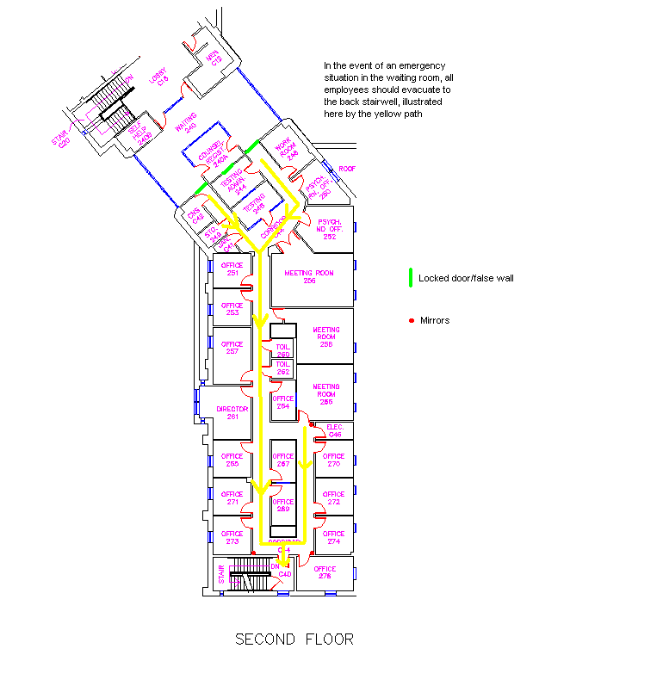
Programs
R.A.D.
Security Survey/Program
Notes:
The Virginia Tech Police Department offers several free safety programs. Rape Aggression Defense class is a free self-defense class offered to females. The Community Outreach Unit offers security surveys of departments, including their building and grounds. This unit also provides educational programs to faculty, staff, students and visitors regarding topics such as personal, vehicular and property security, sexual assault programs, alcohol, and more. A list of topics can be found on the website, as well as how to request them.

Slide 13
Safe Ride
Call 1-SAFE
Sunset to Sunrise
Anywhere on Campus
Notes:
Virginia Tech also provides a service called, “Safe Ride”. This program runs from sunset to sunrise, and will take the community to and from any campus property (including research facilities). If calling from off campus or from a cell phone, dial 231-SAFE.

Slide 14
Clery Report
Online at
www.Police.VT.edu
“A Shared Responsibility”
Notes:
The annual Clery Report provides information about crime on campus, services offered by the Virginia Tech Police Department and safety tips to help make your experience at Virginia Tech a positive one.

Slide 15
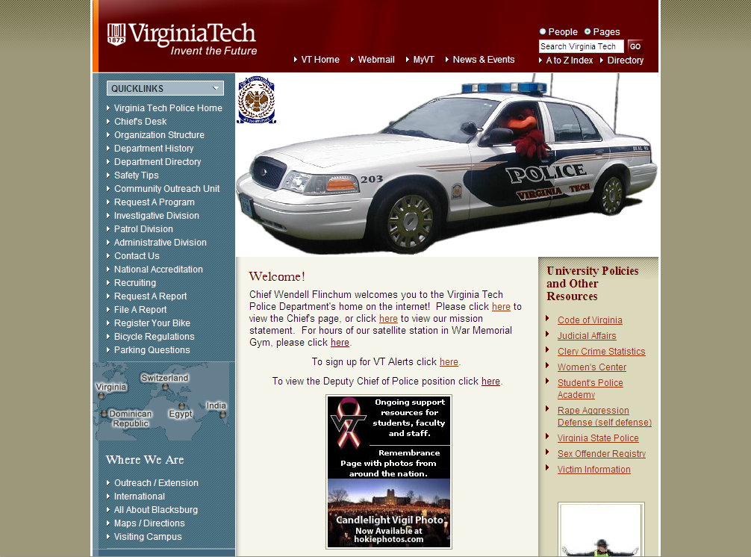
alleng@vt.edu
www.Police.VT.edu
Notes:
All of this information and more can be found online at the Virginia Tech Police Department’s website at www.police.vt.edu.
If you have any questions, email alleng@vt.edu

